Slide 1
Structure Chart
A structure chart represents the software architecture, i.e. the various modules making up the system, the dependency (which module calls which other modules), and the parameters that are passed among the different modules.
Since the main focus in a structure chart representation is on the module structure of the software and the interactions among different modules.
Structure chart is a chart derived from Data Flow Diagram. It represents the system in more detail than DFD. It breaks down the entire system into lowest functional modules, describes functions and sub-functions of each module of the system to a greater detail than DFD.
Structure chart represents hierarchical structure of modules. At each layer a specific task is performed.

Slide 2
The basic building blocks which are used to design structure charts are the following:
  • Rectangular boxes: Represents a module.
  • Module invocation arrows: Control is passed from one module to another module in the direction of the connecting arrow.

Slide 3
• Data flow arrows: Arrows are annotated with data name; named data passes from one module to another module in the direction of the arrow.
• Library modules: Represented by a rectangle with double edges.
• Selection: Represented by a diamond symbol.
• Repetition: Represented by a loop around the control flow arrow.

Slide 4
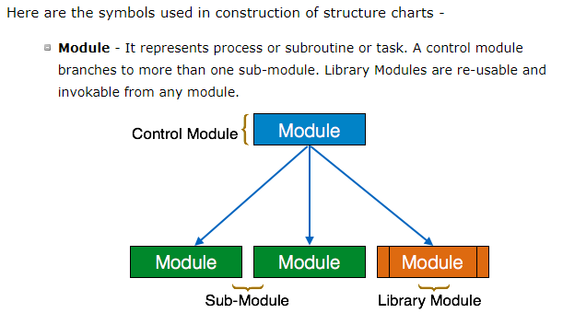

Slide 5
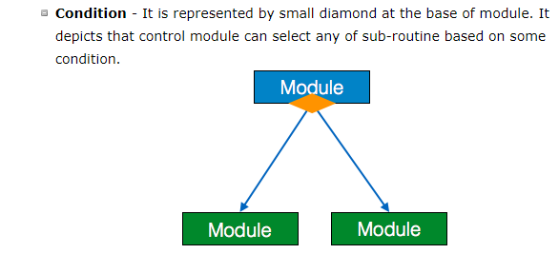

Slide 6
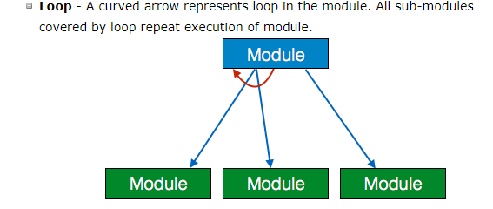

Slide 7
Structure Chart vs. Flow Chart
We are all familiar with the flow chart representation of a program. Flow chart is a convenient technique to represent the flow of control in a program. A structure chart differs from a flow chart in three principal ways:
  • It is usually difficult to identify the different modules of the software from its flow chart representation.
  • Data interchange among different modules is not represented in a flow chart.
  • Sequential ordering of tasks inherent in a flow chart is suppressed in a structure chart.

Slide 8
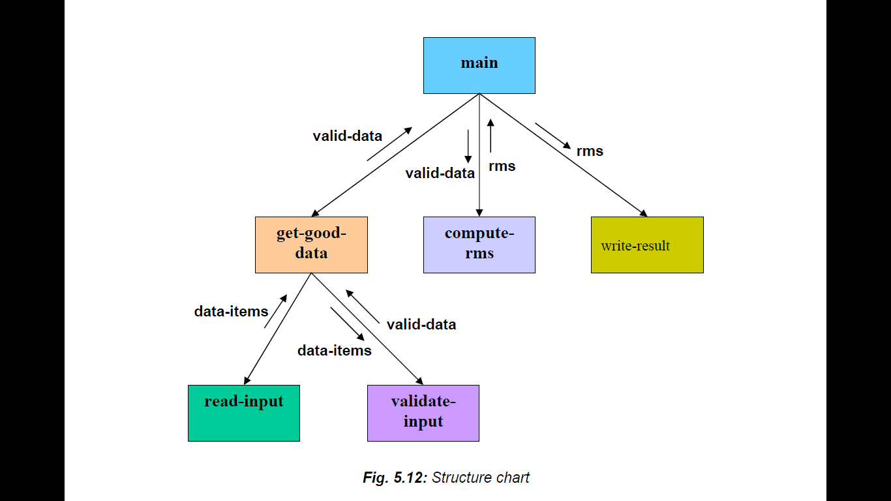
Example: Structure chart for the RMS software

Slide 9
Balancing of DFD
Data dictionary
Data definition

Slide 10
Function Oriented design
Function Oriented design is a method to software design where the model is decomposed into a set of interacting units or modules where each unit or module has a clearly defined function.

Slide 11
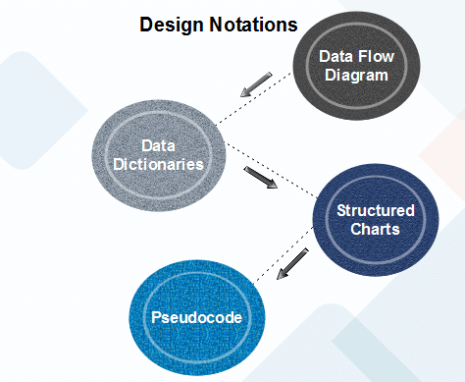
Function Oriented design

Slide 12
Data Flow Diagram
Data-flow design is concerned with designing a series of functional transformations that convert system inputs into the required outputs.
How data flows through a system and how the output is derived from the input through a series of functional transformations.

Slide 13
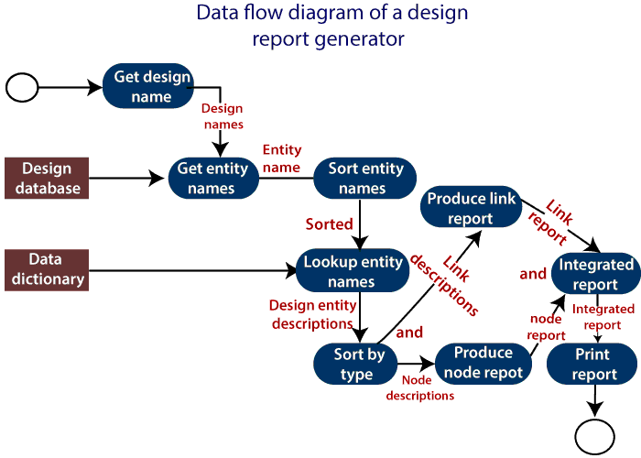

Slide 14
The report generator produces a report which describes all of the named entities in a data-flow diagram. The user inputs the name of the design represented by the diagram.
The report generator then finds all the names used in the data-flow diagram. It looks up a data dictionary and retrieves information about each name. This is then collated into a report which is output by the system.

Slide 15
Structured Charts
It partitions a system into block boxes. A Black box system that functionality is known to the user without the knowledge of internal design.

Slide 16
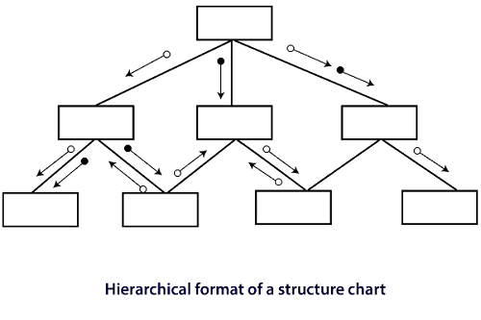
Structure Chart

Slide 17
Structure Chart
Structured Chart is a graphical representation which shows:
System partitions into modules
Hierarchy of component modules
The relation between processing modules
Interaction between modules
Information passed between modules

Slide 18
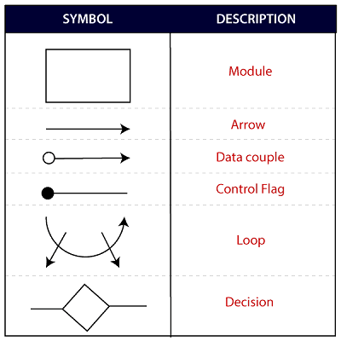
The following notations are used in structured chart:

Slide 19
Pseudo-code
Pseudo-code notations can be used in both the preliminary and detailed design phases.

